Slide 1




SPA Applications and Applications Architecture
What is SPA? MV* architectural design patterns
SoftUni Team
Technical Trainers
Software University
http://softuni.bg

Slide 2


Table of Contents
Single Page Applications
What is a SPA app?
Architectural Design Patterns
MV* patterns - MVC, MVVM and MVP
Sample implementation in JavaScript

Slide 3

Single-page Applications
What and Why?

Slide 4
Single Page Application
A Single-Page Application (SPA) is a web application that fits on a single web page
Page resources are retrieved either at page load or loaded in response to user actions
The page does not reload at any point
SPA apps can contain multiple fake pages
Not real pages, but ones that look like a page

Slide 5
Architecture of SPA Apps
SPA Applications have a different architecture than regular JavaScript applications
Commonly SPA apps have:
A thick layer of server logic (Web services), located in the cloud
Containing both Database and Business logic
A thick client layer, implemented with HTML5 and JavaScript
Containing communication with the server and UI logic

Slide 6

SPA Applications: Pros and Cons

Slide 7
SPA Applications: Pros and Cons
SPA applications have:
Better performance
There is logic on both the server and the client
Lower bandwidth
Only JSON/XML data is send over HTTP
The JSON data is rendered on the client
Higher code reusability
The server gives an API, that is fully decoupled with the UI

Slide 8
SPA Applications: Pros and Cons (2)
Yet SPA applications have their challenges:
The server must have a solid data validation
The client is more easily tampered with
Routing (i.e. History)
The regular user expects to go to the previous screen, not page, when they hit the back button
Easily done with Sammy.js, AngularJS, etc…
A combination of lots of frameworks are required
jQuery is not enough any more…

Slide 9
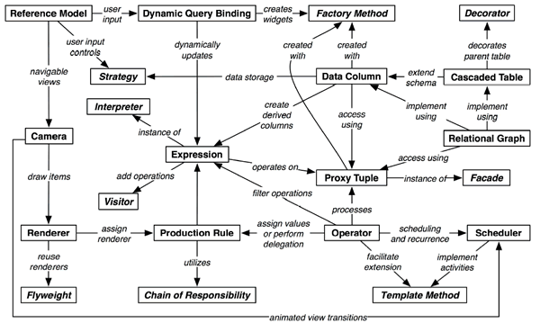
Design Patterns in SPA Application

Slide 10
SPA Applications Architecture
Most SPA applications relay on solid JavaScript business logic
They have a server that contains the database and exposes web services
Web services are kind of requirement for SPA
The JavaScript communicates with the server using HTTP requests and AJAX calls

Slide 11
SPA Architecture
A SPA application is build from some layers to meet the "separation of concerns"
UI layer
Contains Views (HTML, CSS and UI logic)
Data layer
A way to communicate with the server (mainly HTTP requests)
Business layer
The layer that connects the Data with the UI
Contains controllers or view-models

Slide 12
Architectural Patterns in JavaScript
Many design patterns exist that solve the separation of concerns
The most used patterns are the MV* patterns
Model-View-*
The * contains the business logic of the app
MV* has three concrete implementations:
MVC (Model-View-Controller)
MVVM (Model-View-ViewModel)
MVP (Model-View-Presenter)

Slide 13
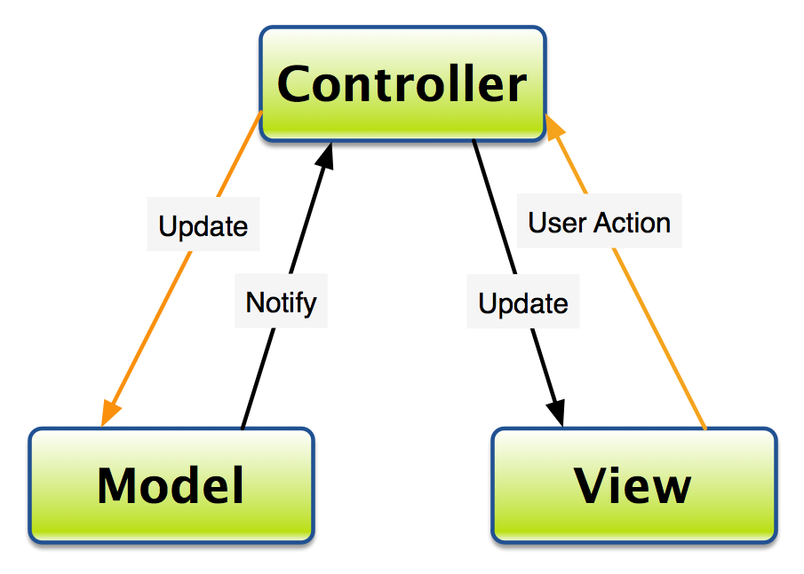
Model-View-Controller
The MVC Pattern

Slide 14
Model-View-Controller
The Model-View-Controller has three sub layers:
Model
Contains data models (JSON or POCO)
View
Contains UI logic (HTML,CSS, UI JS)
Controller
Contains business logic
Fills models with data and passes them to a View
Plays the role of the middleman

Slide 15
MVC Architecture
Controller
(data communication, View rendering)
Knows of
Knows of
Model
(data from and to the server)
View
(HTML, CSS, UI JavaScript)
Knows of

Slide 16
JavaScript Frameworks Implementing MVC
Most of the JavaScript frameworks implement the MVC pattern:
AngularJS
Backbone.js
Ember.js
Sammy.js
Google Closure
Batman.js

Slide 17
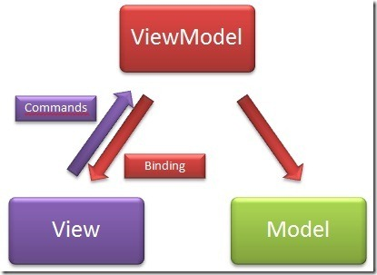
Model-View-ViewModel
The MVVM Architectural Design Pattern

Slide 18
Model-View-ViewModel
Model-View-ViewModel has three sub layers:
Model
Contains data models (JSON or POCO)
View
Contains UI logic (HTML,CSS, UI JS)
ViewModel
Model of the View - The View binds to the VM
Contains business logic
Keeps models of data, Views get what they need
Plays the role of the middleman

Slide 19
MVVM Architecture
View
(HTML, CSS, UI JavaScript)
Binds to
ViewModel
(data communication,
business Logic)
Knows of
Model
(data from and to the server)

Slide 20
JavaScript Frameworks Implementing MVVM
MVVM was designed mostly for use in WPF/Silverlight, but its usable in JavaScript as well
Knockout.js
Knockback.js
Kendo.UI
Kendo UI Mobile

Slide 21


Summary
Single Page Applications
What is a SPA application?
Architectural Design Patterns
MV* patterns - MVC, MVVM and MVP
Sample implementation in JavaScript
JS Apps

Slide 22









Web Storage and Cookies
https://softuni.bg/courses/javascript-applications/

Slide 23
License
This course (slides, examples, demos, videos, homework, etc.) is licensed under the "Creative Commons Attribution-NonCommercial-ShareAlike 4.0 International" license
Attribution: this work may contain portions from
"JavaScript Applications" course by Telerik Academy under CC-BY-NC-SA license

Slide 24




Free Trainings @ Software University
Software University Foundation – softuni.org
Software University – High-Quality Education, Profession and Job for Software Developers
softuni.bg
Software University @ Facebook
facebook.com/SoftwareUniversity
Software University @ YouTube
youtube.com/SoftwareUniversity
Software University Forums – forum.softuni.bg

